Slide 1
ORGANS OF SPEECH
The organs which take part in the production of speech sounds are called speech organs. When we speak air comes out through the lungs and it is interfered at various places for the production of sounds. Sounds can not occur without air.

Slide 2
Organs of Speech
Movable Organs
Lips
Tongue
Soft palate
Uvula
Vocal cords
Lower Jaw
Immovable Organs
Teeth
Teeth Ridge (Alveolar ridge)
Hard Palate
Nasal Cavity

Slide 3
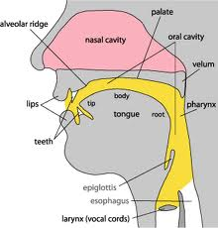
Organs of Speech
Notes:
All sounds we make when we speak are the result of muscle contraction. The muscles in the chest we use for breathing produce the flow of air that is needed for almost all speech sounds; muscles in the larynx produce many different modifications in the flow of air from the chest to the mouth. After passing through the larynx, the air goes through what we call the vocal tract, which ends at the mouth and nostrils.

Slide 4
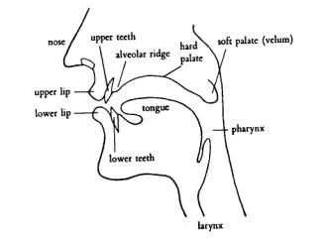
Notes:
The pharynx is a tube which begins just above the larynx. At its top it is divided into two, one part is the back of the mouth and the other is the beginning of the way through Nasal Cavity.

Slide 5
Lips
The upper lip and lower lip help to produce bilabial sounds /p/, /b/, /m/. And labio - dental sounds /f/, /v/ and thus create an important part of speech appartus.

Slide 6
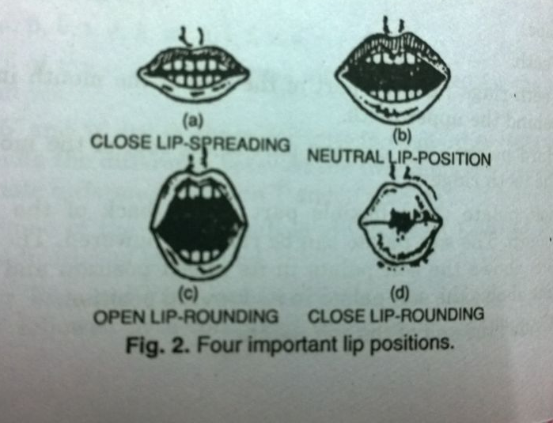
Lips assume four different positions while producing different sounds

Slide 7
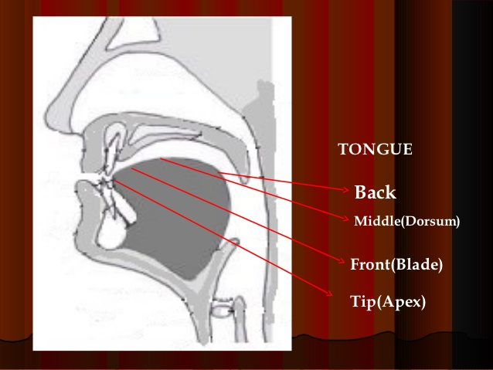
TONGUE

Slide 8
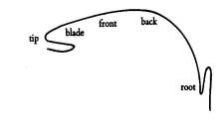
Sub –divisions of the tongue

Slide 9
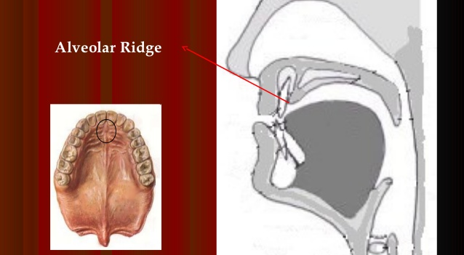
ALVEOLAR RIDGE / TEETH RIDGE
Notes:
HARD RIDGE BEHIND THE UPPER FRONT TEETH . IT IS BETWEEN THE UPPER TEETH AND ROOF OF THE MOUTH.

Slide 10
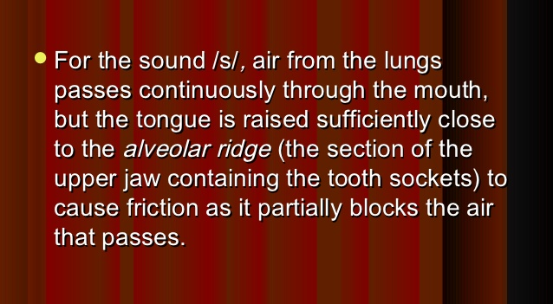

Slide 11
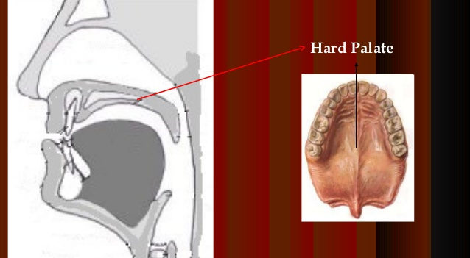
Hard Palate

Slide 12
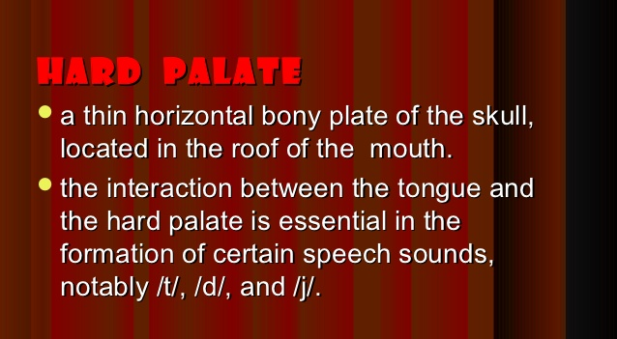
Hard Palate

Slide 13
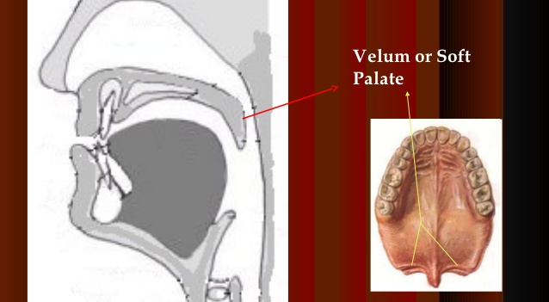
Velum or Soft Palate

Slide 14
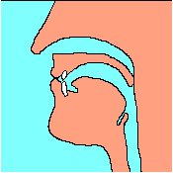
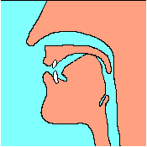
Velum or Soft Palate
Notes:
Soft palate or velum allows air to pass either through nose or through mouth depending on the position of the velum. Often in speech it is in raised position so that the air can not escape through the nose. When we make sound like K and G the tongue is in contact with the lower side of the velum, and we can call these velar consonants.

Slide 15
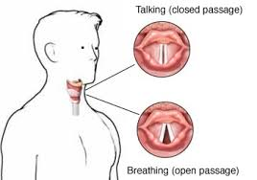
VOCAL CORDS
Notes:
Vocal cords lie in the larynx. These can be made to vibrate or may be stretched apart allowing the air coming from the wind pipe to move out without making audible voice.

Slide 16
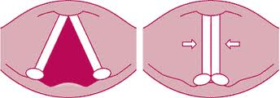
VOCAL CORDS
Notes:
When vocal cords vibrate the quality of sound is voice and when they do not vibrate the quality of sound is whisper. Vocal cords help in differentiating voiced ( vocal cords vibrating) and voiceless sounds (vocal cords not vibrating) .

Slide 17
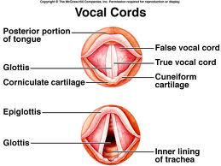
Epiglottis Glottis

Slide 18
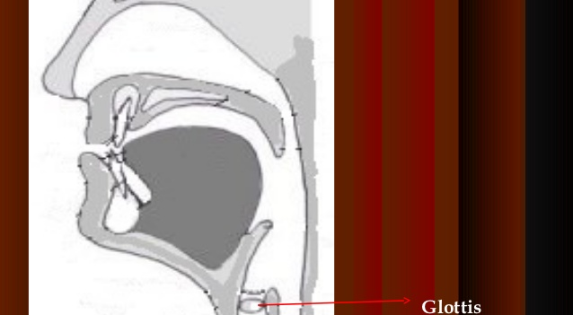
GLOTTIS

Slide 19
THANK YOU

Slide 20
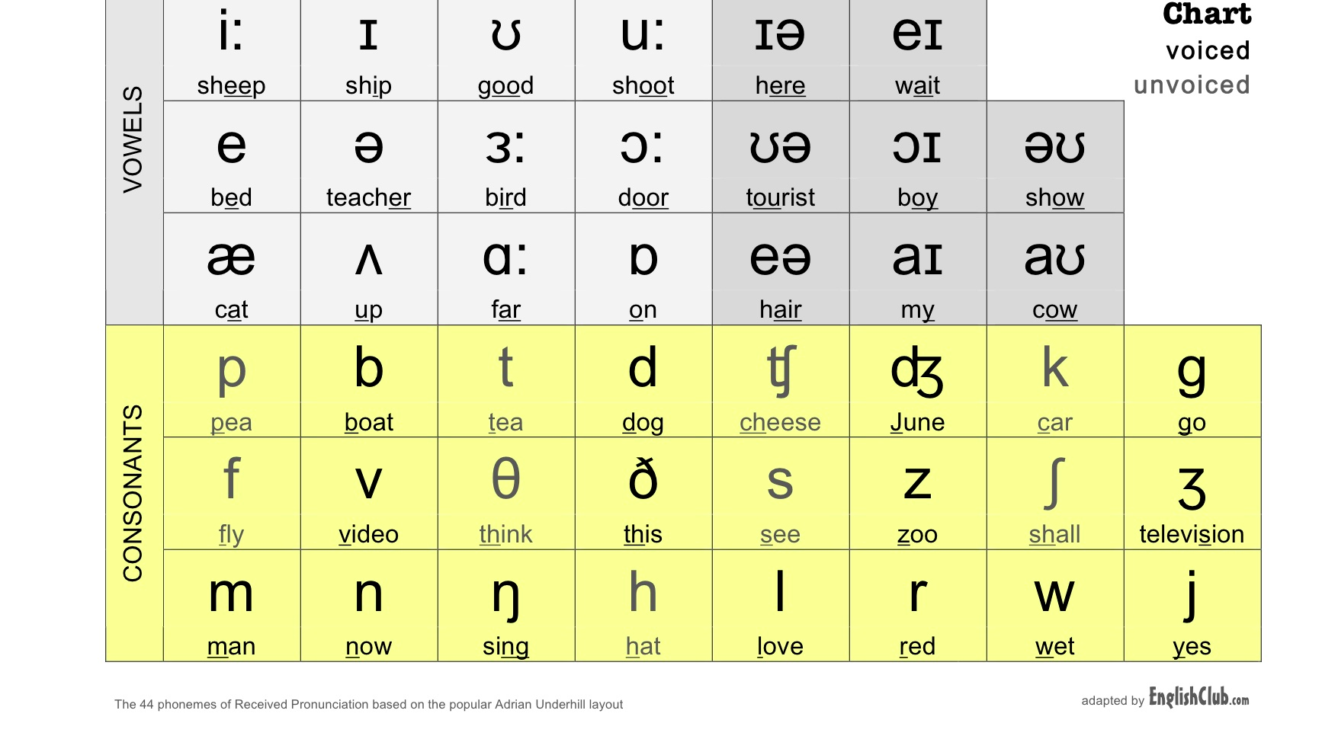
Phonemic Chart

Slide 21
Symbol English Equivalent
I The “ee” in “Fleece” in most varieties of English.
ɪ
The “i” in “Kit” in American & most British dialects
e
The “e” in “Bet” in Australian English. Also, the first vowel in the dipthong “face” in American English.
ɛ
The “e” in “Dress” in most American and British dialects.
æ
The “a” in “Cat” in American English.

Slide 22
English Phonetics and Phonology
Consonant sounds

Slide 23
CLASSIFICATION Of CONSONANTS
English consonants are classified according to :
The place of articulation
The nature of obstruction (complete or partial)
The position of the vocal cords (vibrating or not vibrating )

Slide 24
According to the place of articulation :
1. Bi-Labial : The sounds formed at the two lips. /p/ /b/
2. Labio - dental : The sounds formed at the lower lip and the upper teeth /f/,and /v/
3. Dental :The sounds formed by the tip of the tongue and upper teeth /θ/ /ð/
4. Alveolar : The sounds formed by the tip or blade of the tongue and the teeth ridge /t/ and /d/

Slide 25
According to the place of articulation Contd ...........
5. Palato Alveolar : The sounds formed by the blade of the tongue and the back of alveolar /tʃ/ and /ʃ /
6. Palatal : The sound formed by the front of the tongue and the hard palate. /j/
7. Velar : The sound formed by back of the tongue and the soft palate. /k/ as in lack .
8. Glottal : The sound formed in glottis /h/.

Slide 26
According to Nature of Obstruction
1. Plosives or Stops : The sounds formed by the complete closure of the air passage, which is afterwards released suddenly. /p/ /b/.
2. Affricatives : The sounds formed by the complete closure of the air passage, which is afterwards released slowly. /tʃ/ and dʒ
3. Fricatives : The sounds formed by narrowing the air passage to such an extent that the air in escaping produces audible friction. /f/ and /v/

Slide 27
According to Nature of Obstruction Contd …….
4. Nasals : The sounds formed by a complete closure in the mouth while nasal passage is open. /m/, /n/, /ŋ/.
5. Lateral : The sound formed by means of a partial obstruction of the passage by the tongue at the centre of the mouth and allowing the air to pass freely one or both sides of the tongue . /l/.
6. Semi vowels : These are voiced gliding sounds in which the speech organs shift from one position to another.
/w/ and /j/ <number>

Slide 28
According to Position of the Vocal Cords
There are two kinds :-
1. Voiced : The voiced consonants are those in the production of which the vocal cords vibrate.
2. Voiceless : The voiceless consonants are those in the production of which the vocal cords do not vibrate.
Voiceless : /p/ , /t/ , /k/ , /f/ , /s/ , /ʃ/ , /θ/ , /tʃ/ , /h/
Voiced : /b/ , /d/ , /g/ , /v/ , /z/ , /ʒ/ , /ð/ , /dʒ/ , . /m/, /n/, /ŋ/, /l/, /r/

Slide 29
Description of English
Consonants

Slide 30
1. Plosives or Stops
i. Bi – Labial Plosives /p/ , /b/
The air passage is completely blocked
By closing the lips and raising the soft
Palate.
When the lips are opened the air rushes
out with an explosives sound.
The vocal cords do not vbrate for /p/
But vibrate for /b/

Slide 31
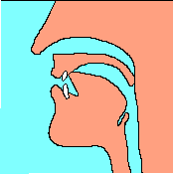
ii. Alveolar Plosives /t/ & /d/
The air passage is completely blocked by pressing the tip of the tongue against the teeth ridge, and by raising the soft palate.
When the tongue is removed from the teeth ridge the air rushes out with an explosive sound.
The Vocal cords do not vibrate for /t/, but not for /d/

Slide 32
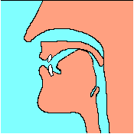
iii. Velar Plosives /k/, /g/
The air passage is completely blocked
by pressing the back of the tongue against
Teeth ridge and by raising the soft palate.
When the tongue is removed from the soft palate the air rushes out with an explosive
Sound.
The Vocal cords do not vibrate for /k/ but
vibrate for /g/

Slide 33
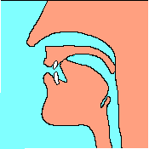
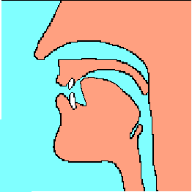
2. Affricates : Palato - Alveolar /tʃ/ , /dʒ/
The air passage is narrowed by
raising the front of the tongue
against hard palate and by raising
the soft palate.
The sound is produced by
small opening instead of the
complete opening of the stop.
This small opening causes friction
just like a fricative.
The vocal cords do not vibrate for /tʃ/
and vibrate for /dʒ/
Here are the two main phases.
1. Hold
2. Release with constriction

Slide 34
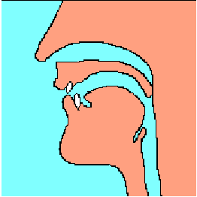
3. Fricatives
i. Labio – Dental /f/ , /v/
The air passage is partially closed by
pressing the lower lip against the
upper teeth.
The soft palate is in its raised position
The air escapes through the narrow
opening between teeth and lips, producing a hissing noise.
The vocal cords do not vibrate for /f/ but vibrate for /v/

Slide 35
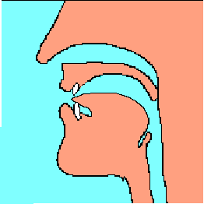
ii. Dental Fricatives : /θ/ , /ð/
The air passage is partially closed by
placing the tip of the tongue behind upper teeth.
The soft palate is in its raised position and the nasal passage is closed.
The air escapes through the narrow opening between the teeth , producing a hissing noise.
The vocal cords do not vibrate for /θ/ and vibrate for /ð/

Slide 36
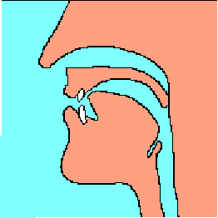
iii. Alveolar Fricatives /s/ and /z/,
The blade of the tongue is raised
high towards the teeth ridge, thus
leaving a very narrow space for the air to pass through.
The soft palate is in its raised position and the nasal passage is closed .
The air passes through the tongue and teeth with audible friction. as air hits the upper teeth causing a hiss.
The Vocal cords do not vibrate for
/s/ and /z/,

Slide 37
4. Palato Alveolar : /ʃ/ , /ʒ/
The passage is partially closed by
Towards the hard raising the blade
of the tongue towards the hard palate
A further back than for /s/ and /z/.
The soft palate is in raised position and nasal passage is closed.
The air escapes through a passage down the middle of the tongue, which is narrower than in case of /s/ and /z/.
The Vocal cords do not vibrate for /ʃ/ but vibrate for /ʒ/

Slide 38
5. Glottal /h/
/h/ sound is produced by the air coming through a
narrow glottis with audible friction.
The soft palate is in its raised position.
The vocal Cords do not vibrate.
Examples : hay, here , heat

Slide 39
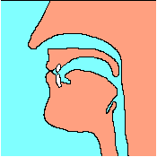
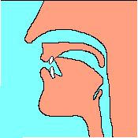
6. Nasals - . /m/, /n/, /ŋ/,
For /m/, the mouth is
completely blocked by closing the lips
For /ŋ/, it is blocked
by raising the back
of the tongue to touch the soft palate
For /n/, it is blocked by
raising the tip of the tongue against teeth ridge.
/m/
/n/
/ŋ/
Alveolar /n/ /
Velar /ŋ/
Bi-labial /m/
The soft palate is lowered so that the air passes through the nose.
The Vocal cords are made to vibrate in each case.

Slide 40
Lateral
The sound formed by means of a partial obstruction of the passage by the tongue at the centre of the mouth and allowing the air to pass freely one or both sides of the tongue . /l/.

Slide 41
7. Lateral : /l/
Two types of /l/
1. Clear /l/ - is used initially in a word and
in the middle of a word before a vowel. E.g Lake , telling
2. Dark /l/ - is used in the middle of a word before a consonant
And at the end of a word. E.g. help , sell .

Slide 42
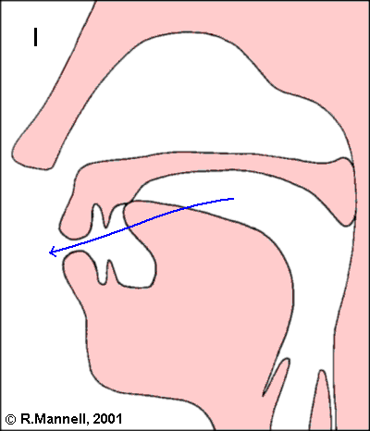
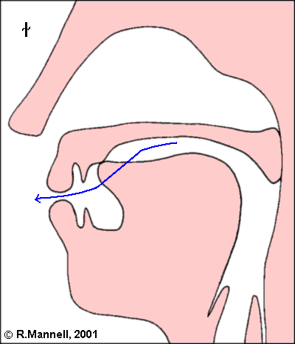
Lateral : /l/ Contd ……..
The tip of the tongue is pressed against the teeth ridge in both types.
There is a difference in the shape of the main body of the tongue.
In Clear /l/ the tip of the tongue is raised towards hard palate.
In Dark /l/ the back of the tongue is raised against soft palate.
The tongue is contracted sideways and the air escapes at the side of the tongue.
The Vocal Cords
vibrate
While saying
Clear /l/
While saying
Clear /l/

Slide 43

8. Frictionless Continuant
Post Alveolar /r/
The air passage is partially closed by raising the tip of the tongue
against the back part of the teeth ridge. The tongue is however not in
contact with the teeth ridge.
The soft palate is in a raised position.
The air escapes through the mouth
without any friction.
The vocal cords vibrate.

Slide 44
Semi Vowels /w/ and /j/
Bi – Labial /w/ :
The back of the tongue is raised towards the soft palate.
The soft palate is in its raised position.
The lips are closely rounded.
The Vocal cords vibrate.
Palatal - /j/
The front of the tongue is raised towards the hard palate.
The lips are spread or neutral.
The Vocal cords vibrate.

Slide 45

ɪ

Slide 46
Classification of English vowels
Vowel sounds are classified according to:
the position of the tongue in the mouth,
the openness of the mouth,
the shape of the lips,
and the length of the vowels.

Slide 47
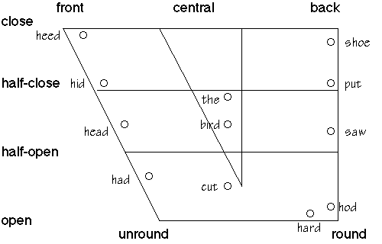
1. According to the position of the tongue in the mouth

Slide 48
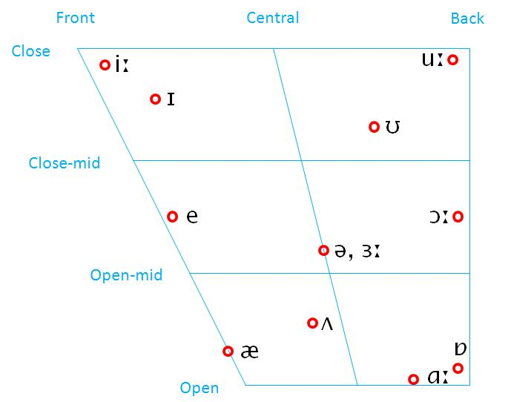

Slide 49
/iː/
Height of the tongue - Nearly Close
Part of the tongue which is highest – Front
Position of lips - unrounded
Opening between the jaws – narrow to medium

Slide 50
/ɪ/
Height of the tongue - a little above half close
Part of the tongue which is highest – the hinder part of the Front
Position of lips - unrounded
Opening between the jaws – narrow to medium

Slide 51
/e/ as in dress, bed, head
Height of the tongue - intermediate half close and half open
Part of the tongue which is highest –Front
Position of lips – spread or neutral
Opening between the jaws –medium

Slide 52
/æ/
Height of the tongue – Between half open and open
Part of the tongue which is highest - front
Position of lips – spread or neutral
Opening between the jaws – medium to wide

Slide 53
/ɑː/ start, father
Height of the tongue – fully open
Part of the tongue which is highest – centre of the back
Position of lips – neutral
Opening between the jaws – medium to wide
ɑː

Slide 54
ɒ lot, odd, wash
Height of the tongue – fully open
Part of the tongue which is highest - back
Position of lips –open lip rounding
Opening between the jaws – medium to wide

Slide 55
/ɔː/ thought, law, north, war
Height of the tongue – between half open and open
Part of the tongue which is highest - back
Position of lips – rounding
Opening between the jaws - medium to fairly wide

Slide 56
ʊ foot, good, put
Height of the tongue – just above half close
Part of the tongue which is highest - the fore part of the back
Position of lips – close in rounding
Opening between the jaws – medium

Slide 57
uː goose, two, blue, group
Height of the tongue – nearly close
Part of the tongue which is highest – the back
Position of lips –close lip rounding
Opening between the jaws – medium

Slide 58
/ʌ/ strut, mud, love, blood
Height of the tongue – half open
Part of the tongue which is highest – fore part of the back
Position of lips – spread
Opening between the jaws – wide

Slide 59
/ɜː/ nurse, stir, learn, refer
Height of the tongue – between open and close
Part of the tongue which is highest – the central part
Position of lips –spread
Opening between the jaws – narrow

Slide 60
/ə/ about, common, standard
Height of the tongue – mid way between half close half open
Part of the tongue which is highest - central
Position of lips –neutral
Opening between the jaws – medium

Slide 61
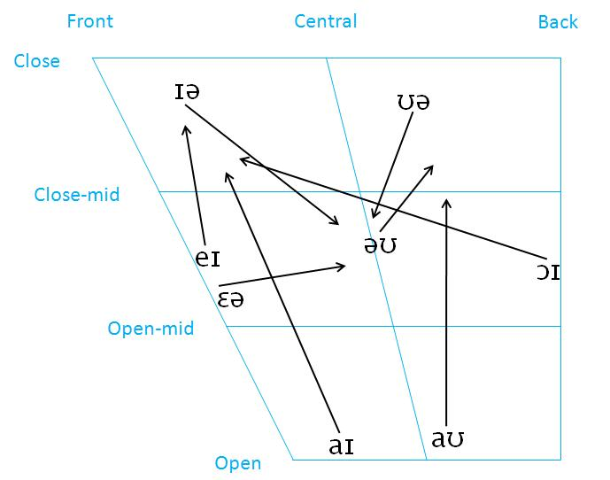
Dipthongs

Slide 62
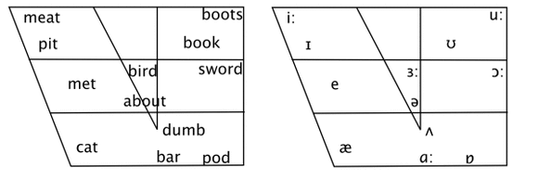

Slide 63
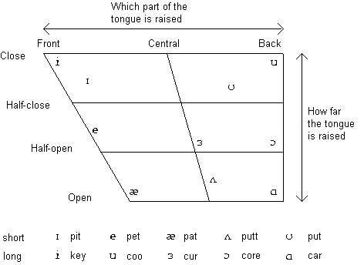
1. According to the position of the tongue in the mouth

